Slide 1
Retrieval Augmented Generation (RAG) with LangChain
Enhancing Language Models with External Knowledge
Notes:
"Good afternoon, everyone. My name is Daniel Lee and Today, I’ll be presenting on Retrieval Augmented Generation (RAG) with LangChain and how it enhances language models by integrating external knowledge. Let’s dive in!"

Slide 2

Introduction
RAG enhances language models by integrating external knowledge.
Helps models generate more accurate and contextually relevant responses.
Addresses limitations of static training data by allowing real-time information retrieval.
Notes:
Retrieval augmented generation or commonly known as RAG is a powerful technique that improves AI models by integrating external data sources.
It allows models to generate more accurate, contextually relevant responses.
Unlike traditional models that rely only on pre-trained data, RAG enables real-time information retrieval to keep responses updated and relevant."

Slide 3
Implementing RAG with LangChain
Install Dependencies
Load Data: Use Loader to fetch content.
Process Data: Use Splitter function.
Index Data: Store document chunks in a Vector Store.
Build RAG Chain: Retrieve relevant data & generate responses
Notes:
"To implement RAG using LangChain, we follow these key steps:
Install Dependencies – Install the necessary libraries.
Load Data – Use loaders to fetch content from different sources.
Process Data – Split large documents into manageable chunks.
Index Data – Store the processed data in a vector database.
Build the RAG Chain – Retrieve relevant data and generate AI-powered responses

Slide 4
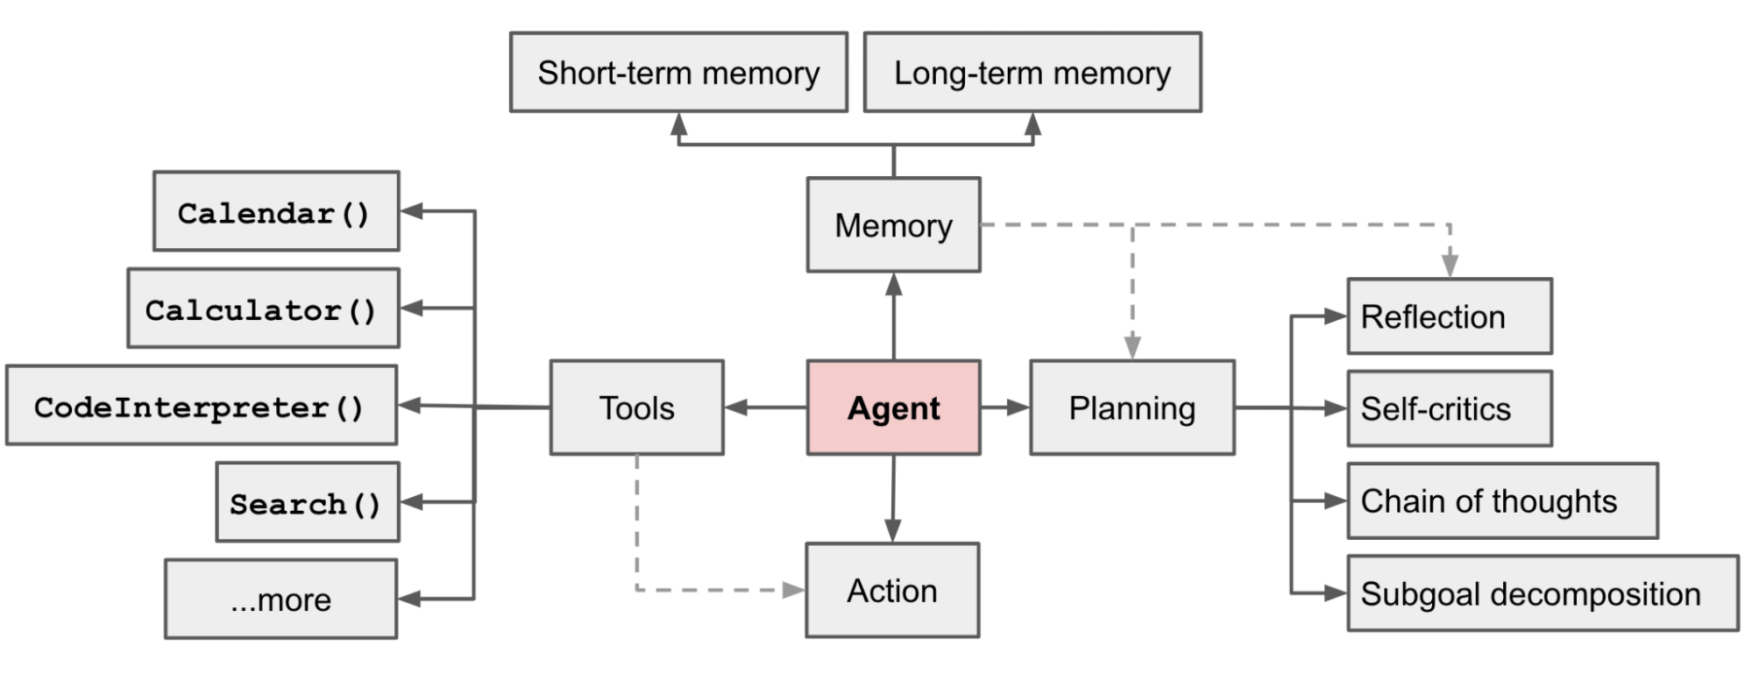
Data Source: Agent-based Approach in AI
Data: Lilian Weng's post titled "Agent-based Approach in AI." converted to text file
Main Concepts:
Introduction to the idea of AI agents that autonomously perform tasks.
Focus on different types of agents in reinforcement learning, multi-agent systems, and robotics.
Discusses how agent systems can integrate into various real-world applications.
Notes:
"The data we used for analysis comes from Lilian Weng’s blog post, 'Agent-based Approach in AI':
The post explores AI agents that autonomously perform tasks.
It discusses various agent types, including reinforcement learning agents and multi-agent systems.
This knowledge is key to understanding how AI agents interact and make decisions in different environments."

Slide 5
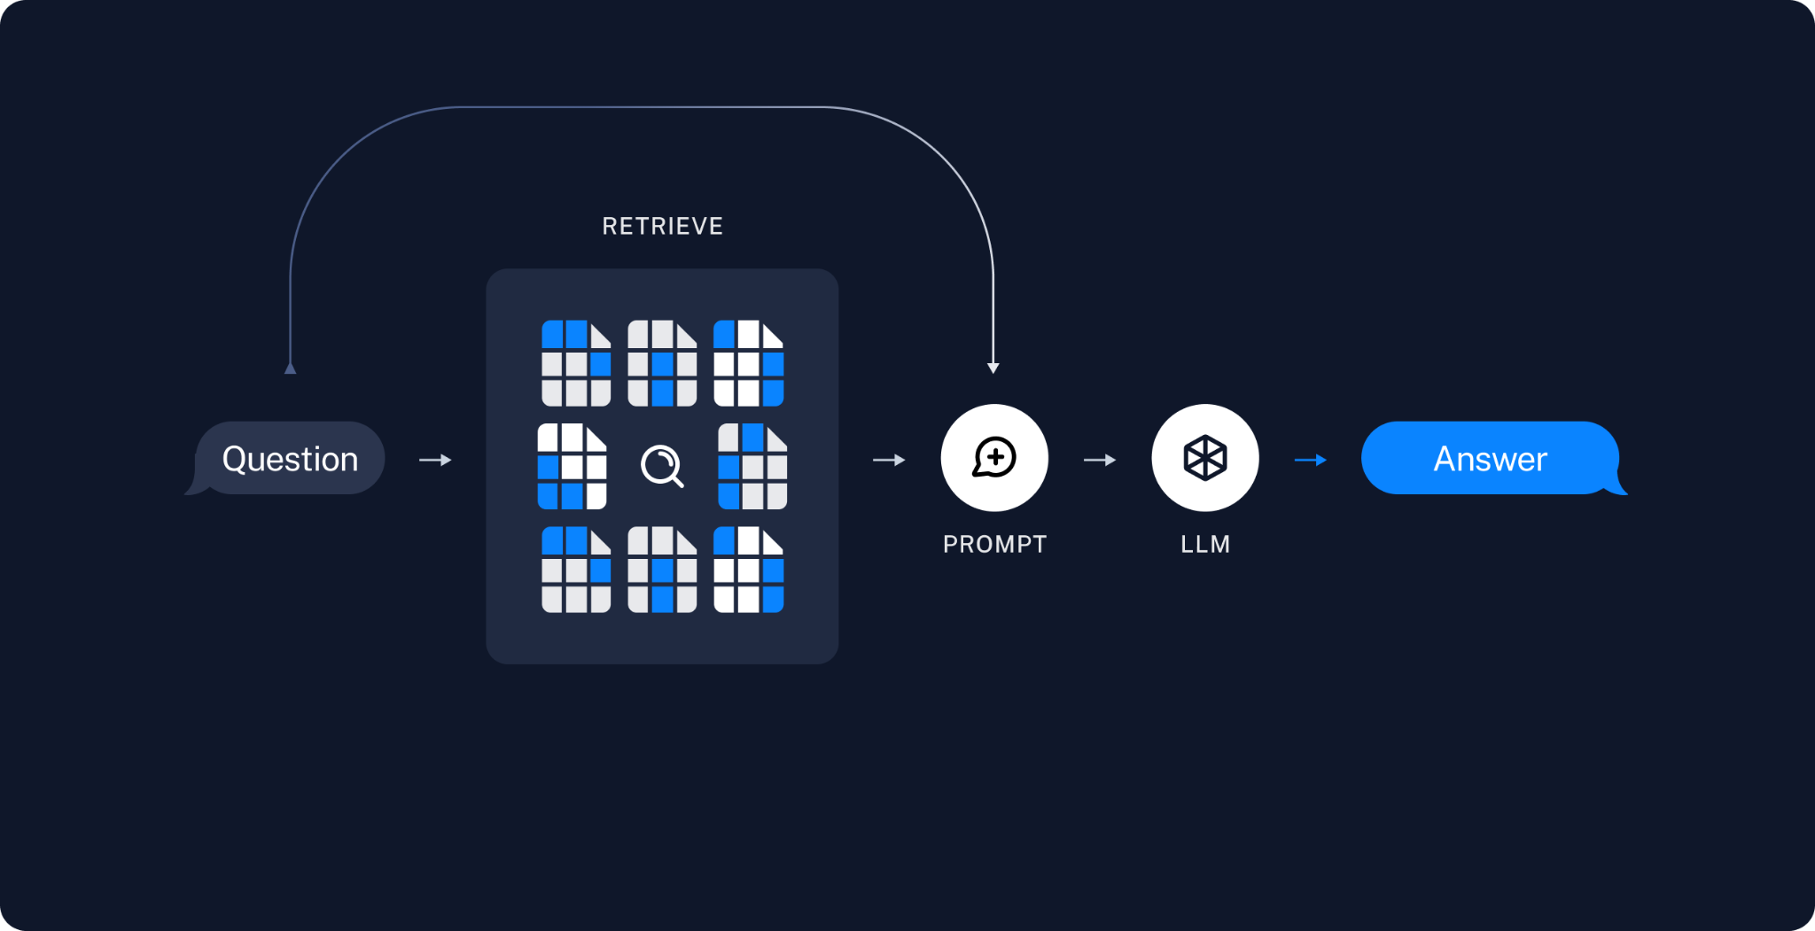
Key Components of a RAG Application
Indexing
Data Ingestion
Text Splitting
Storage
Retrieval & Generation
Query Processing
Response Generation
Notes:
"There are two major components of a RAG system:
Indexing – This involves data ingestion, text splitting, and storing data in a retrievable format.
Retrieval & Generation – This ensures that relevant data is retrieved efficiently and used to generate meaningful responses."
Indexing in RAG
Data Ingestion: Use Document Loaders to import data.
Text Splitting: Use Text Splitters to divide large documents.
Storage: Save chunks in a Vector Store for efficient retrieval.
Retrieval & Generation Process
Query Processing: Retrieve relevant information from the Vector Store.
Response Generation: Use a language model to generate responses.
Ensures accurate, enriched responses using external data.

Slide 6
Application of the Data Analysis
AI Agents: Enhance agent-based models by providing up-to-date information and context for decision-making.
Reinforcement Learning: Use retrieved knowledge to optimize agent learning and reward systems.
Multi-agent Systems: Enable agents to collaborate or compete by sharing external knowledge, improving system efficiency.
Notes:
"The data retrieved through RAG has several key applications:
AI Agents: It enhances AI agents by giving them access to up-to-date knowledge.
Reinforcement Learning: It optimizes agent learning by providing useful external context.
Multi-agent Systems: It improves coordination among agents by sharing relevant information."

Slide 7
Conclusion
RAG in LangChain:
Enhances language models with real-time, relevant information from external data.
Simplifies building RAG applications with tools for data ingestion, retrieval, and response generation.
Key Takeaways:
RAG improves the accuracy and context of AI responses.
LangChain provides a modular, scalable solution for RAG-based systems.
Notes:
IN SUMMARY:
Recap of RAG in LangChain:
RAG Generation enhances language models by integrating external data, allowing for more contextually relevant and accurate responses.
LangChain provides an easy-to-use framework for building RAG applications with tools for data ingestion, text splitting, vector storage, and response generation.
Key Takeaways:
RAG allows language models to go beyond static training data by pulling in real-time information.
The ability to access and retrieve external knowledge greatly enhances applications like chatbots, virtual assistants, and search engines.
LangChain offers an accessible and modular solution to build and scale RAG-based systems.
"Thank you for your time! I’d be happy to answer any questions."

